Slide 1
Merge Sort and Quick Sort
Presented
by Yash Panchal

Slide 2
Introduction to Sorting Algorithms
Content
Sorting algorithms are used to arrange elements in a particular order. Two popular efficient sorting algorithms are Merge Sort and Quick Sort.
Here's a simple example:
let numbers = [5, 2, 9, 1, 5, 6]; numbers.sort();
//This will sort the array in ascending order.
console.log(numbers); // Output: [1, 2, 5, 5, 6, 9]

Slide 3
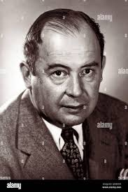
Merge Sort - Overview
Content
Definition: Merge Sort is a Divide and Conquer algorithm that divides the array into halves, sorts them, and then merges them.
Inventor: John von Neumann in 1945.

Slide 4
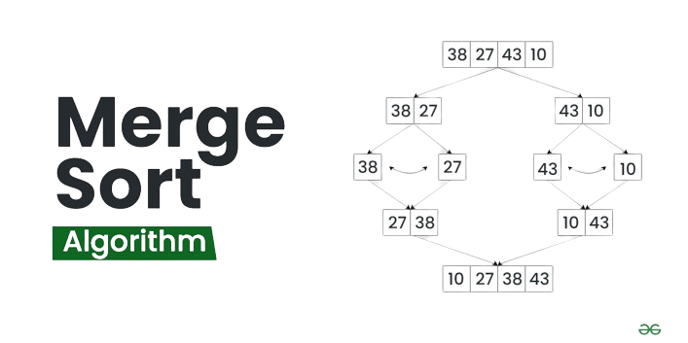
Merge Sort Data Structure and Algorithms Tutorials
Merge sort is a popular sorting algorithm known for its efficiency and stability. It follows the divide-and-conquer approach to sort a given array of elements.
Here’s a step-by-step explanation of how merge sort works
Divide: Divide the list or array recursively into two halves until it can no more be divided.
Conquer: Each subarray is sorted individually using the merge sort algorithm.
Merge: The sorted subarrays are merged back together in sorted order.
The process continues until all elements from both subarrays have been merged.

Slide 5
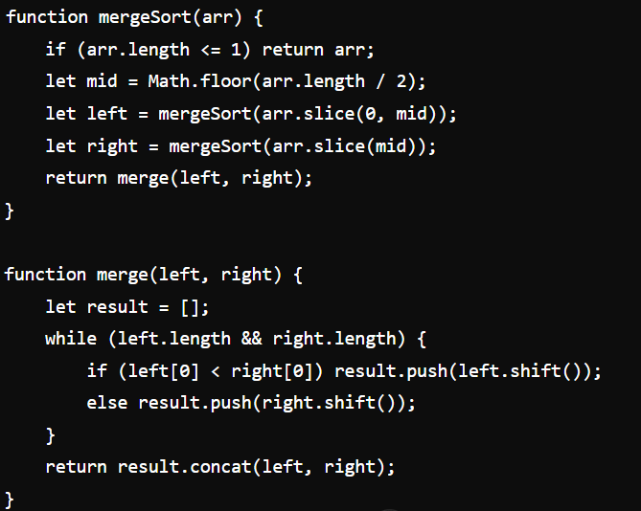

Merge Sort Pseudocode

Slide 6
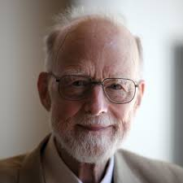
Quick Sort
Content
Definition: Quick Sort is a Divide and Conquer algorithm that selects a pivot element and partitions the array around the pivot.
Inventor: Tony Hoare in 1959.

Slide 7
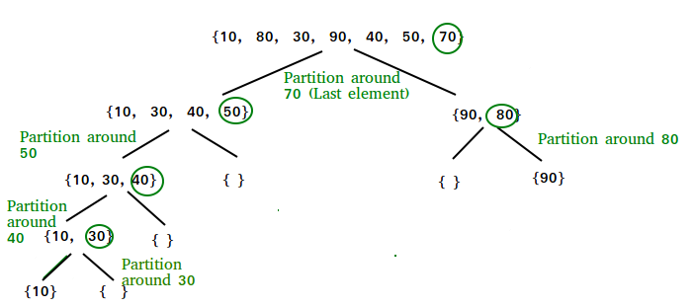
Merge Sort – Data Structure and Algorithms Tutorials
The key process in quickSort is a partition() . The target of partitions is to place the pivot (any element can be chosen to be a pivot) at its correct position in the sorted array and put all smaller elements to the left of the pivot, and all greater elements to the right of the pivot.
Partition is done recursively on each side of the pivot after the pivot is placed in its correct position and this finally sorts the array.

Slide 8
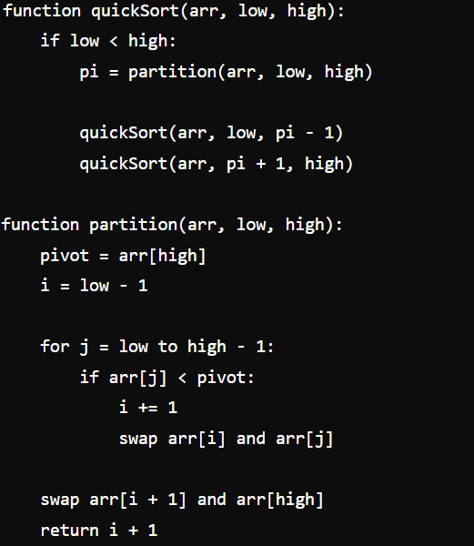
Quick Sort - Pseudocode

Slide 9
Comparison
Stability
Merge Sort is stable; Quick Sort is not.
Space Complexity
Merge Sort uses O(n) extra space; Quick Sort uses O(log n) space.
Performance
Quick Sort is generally faster but Merge Sort has consistent performance.

Slide 10
THANK YOU

